Slide 1
YOLO Tracking

Slide 2
Outline
What is YOLO?
Kalman Filter Tracking
Report requirement

Slide 3
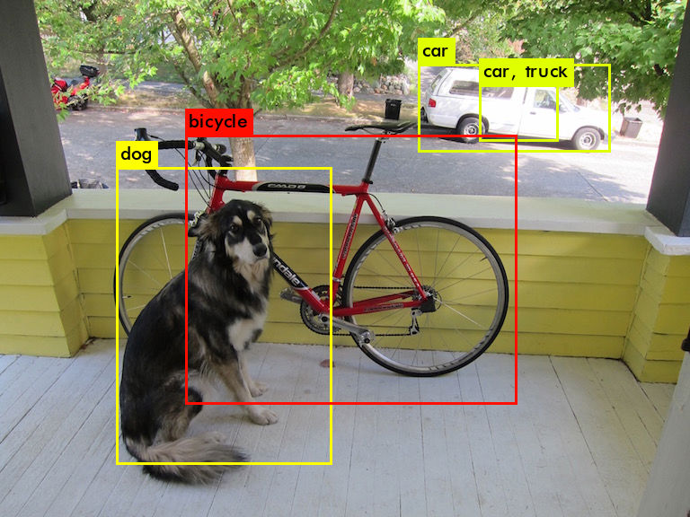

What is YOLO?
You only look once (YOLO) is a state-of-the-art, real-time object detection system.

Slide 4
YOLO message
/darknet_ros/bounding_boxes
message type: darknet_ros_msgs/BoundingBoxes
/darknet_ros/detection_image
message type: sensor_msgs/Image

Slide 5
Message type
darknet_ros_msgs/BoundingBoxes
Header header
Header image_header
BoundingBox[] bounding_boxes
darknet_ros_msgs/BoundingBox
string Class
float64 probability
int64 xmin
int64 ymin
int64 xmax
int64 ymax

Slide 6
Kalman Filter Tracking
initialization
prediction
data association
updating

Slide 7
Tracking
Prediction
In prediction stage, objectVector will predict all object state by Kalman Filter.
Data association
Use n object state to associate with m new coming measurement.
Hungarian algorithm is a combinatorial optimization algorithm that solves the associate problem in polynomial time. (You don’t need to implement this!)
We calculate loss between each object and each measurement by loss function: distance + boxsize error. We can get n x m loss matrix and into Hungarian algorithm and it will return optimal solution.
Updating
According association between object state and measurement, we can update our kalman filter correctly.

Slide 8
Kalman Filter
Implement in “include/KalmanTracker.h”
cv::Mat meas, state[x, y, v_x, v_y, w, h]
cv::Mat measurementMatrix, transitionMatrix (6x6 Matrix)
processNoiseCov, measurementNoiseCov, errorCovPre...

Slide 9
notes
decompress image: rosrun image_transport republish compressed in:=/camera/image_raw raw out:=/camera/image_raw

Slide 10
Report requirement
Easy case video (80%)
Hard case video (20%)
upload your video and submit url.txt to new e3 system.
You can use kazam to record your screen in ubuntu.

